Slide 1
Executing Selenium Test from Command Prompt, Ant Config
Ritesh Sachdeo, Nagpur GDC

Slide 2
What we are going to cover in this session?
How to execute selenium test using command prompt.
What is the use of ant in selenium.
What is Apache ant.
What is ant tool.
Benefits of Ant build.
How to install ant in selenium.
How we can use the ant in program.

Slide 3
How to execute selenium test using command prompt.
Before executing testcases from command line you should have setup ready, if you still have not done then please follow the below link and complete setup part-
http://learn-automation.com/configure-eclipse-for-selenium/
Once you start designing test case continuously your test cases count will increase so you have to manage your test cases accordingly.
TestNG having very interesting concept of creating xml file based on your requirement and put all relevant test cases inside testng.xml file and run it as a Test Suite.

Slide 4
Scenario – If you have 50 test case for application 1 and 70 test case for application 2 and 100 test case for application3 so in this case we can create 3 xml (1 xml for each app) and run them either individually or run all xml in one shot. Precondition-
TestNG should be installed.
Multiple xml file should be created.
Class-path should be set.

Slide 5
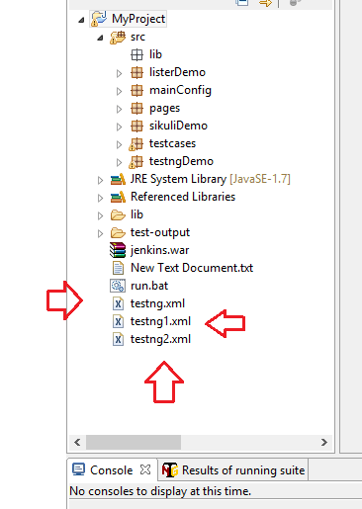
Run selenium test from command line
Step 1- Create multiple testng.xml files and store all xml into project home directory as given below.

Slide 6
Step 2- Set classpath now
Some key points to remember-
1-Put all the jars (Selenium jars) into separate folder and put that folder into project home directory
in my case- I created lib folder (you can keep name based on your choice) and I kept all jars inside it which we downloaded from Selenium website.
Refer below screenshot of Lib folder and I have shown only some jars but you have to kept all files.

Slide 7
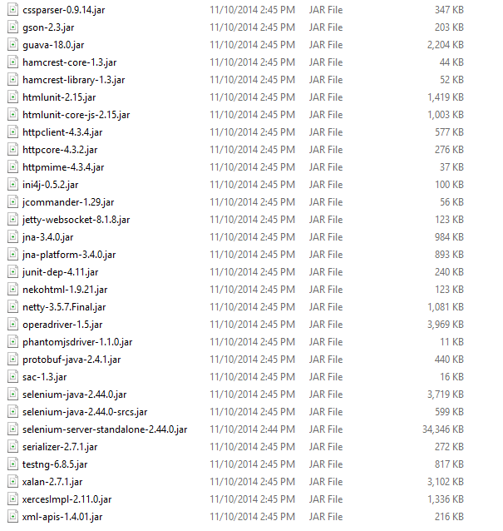

Slide 8
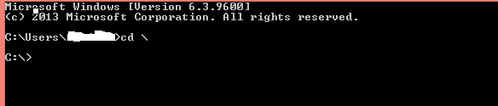
2- Open command prompt and type cd\ and press enter.

Slide 9
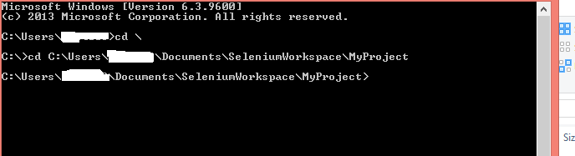
Now go to project home directory for this type cd directory path and enter

Slide 10
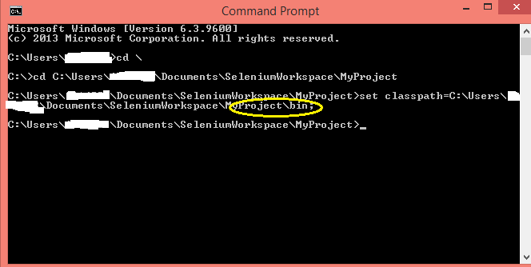
Now we can set classpath for this,specify bin folder.
Home Directory > set classpath=Home Directory\bin; and press enter

Slide 11
Step 3-Now run xml file using below command
Home-directory > java org,testng.TestNG testng.xml testng2.xml testng2.xml and hit enter

Slide 12
What is the use of ant in selenium.
Ant is a build tool for Java. Ant used for code compilation, deployment, execution process. Ant can be downloaded from Apache website. Build.xml file used to configure execution targets using Ant. Ant can be run from the command line or suitable IDE plugin like eclipse.
What is Apache ant.
While creating a complete software product, one needs to take care different third party API, their classpath, cleaning previous executable binary files, compiling our source code, execution of source code, creation of reports and deployment code base etc. If these tasks are done one by one manually, it will take an enormous time, and the process will be prone to errors.

Slide 13
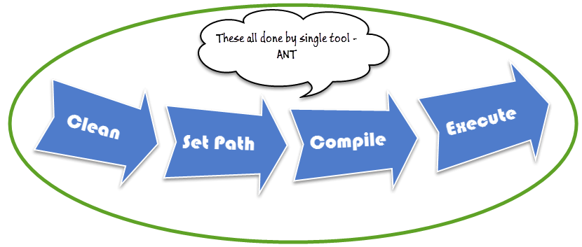
Here comes the importance of a build tool like Ant. It stores, executes and automates all process in a sequential order mentioned in Ant's configuration file (usually build.xml).

Slide 14
What is ant tool?
Apache Ant is a Java library and command-line tool whose mission is to drive processes described in build files as targets and extension points dependent upon each other. The main known usage of Ant is the build of Java applications.
Benefits of Ant build.
Ant creates the application life cycle i.e. clean, compile, set dependency, execute, report, etc.
Third party API dependency can be set by Ant i.e. other Jar file's class path is set by Ant build file.
A complete application is created for End to End delivery and deployment.
It is a simple build tool where all configurations can be done using XML file and which can be executed from the command line.
It makes your code clean as configuration is separate from actual application logic.

Slide 15
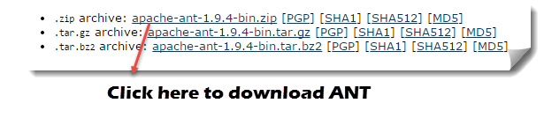
How to install ant in selenium.
Step 1) Go to http://ant.apache.org/bindownload.cgi Download .zip file from apache-ant-1.9.4-bin.zip

Slide 16
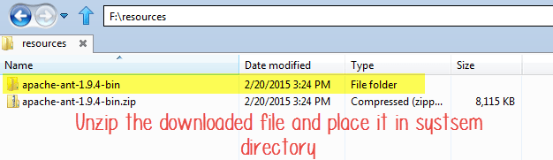
Step 2) Unzip the folder and go to and copy path to the root of unzipped folder.

Slide 17
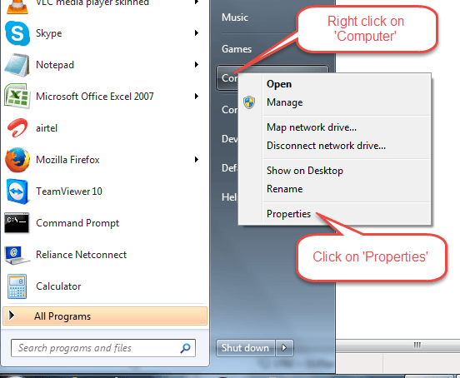
Step 3) Go to Start -> Computer -> right click here and select 'Properties' then click on Advanced System Settings

Slide 18
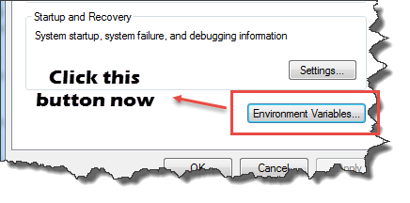
Step 4) A new window opens. Click on 'Environment Variable…' button.

Slide 19
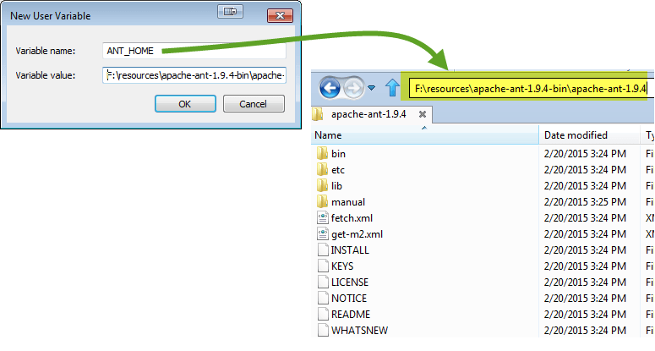
Step 5) Click 'New…' button and set variable name as 'ANT_HOME' and variable value as the root path to unzipped folder and click OK.

Slide 20
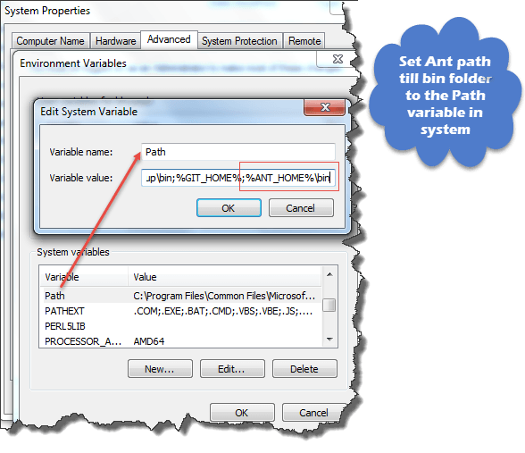
Step 6) now select 'Path' variable from the list and click 'Edit' and append; %ANT_HOME%\bin.
Restart system one time and you are ready to use Ant build tool now.

Slide 21
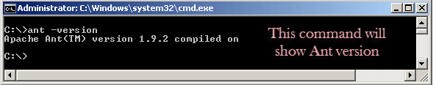
Step 7) To check the version of your Ant using command line: Ant –version

Slide 22
How we can use the ant in program.
Steps to follow:
Create a Java project called de.vogella.build.ant.first in Eclipse. Create a package called math and the following class.
Example :
package math;
public class MyMath {
public int multi(int number1, int number2) {
return number1 * number2;
}
}

Slide 23
Create the test package and the following class.
Example :-
package test;
import math.MyMath;
public class Main {
public static void main(String[] args) {
MyMath math = new MyMath();
System.out.println("Result is: " + math.multi(5, 10));
}
}

Slide 24
Create a new file through the File ▸ New ▸ File menu and create the build.xml file. Implement the following code to this file.
Example:-
<?xml version="1.0"?>
<project name="Ant-Test" default="main" basedir=".">
<!-- Sets variables which can later be used. -->
<!-- The value of a property is accessed via ${} -->
<property name="src.dir" location="src" />
<property name="build.dir" location="bin" />
<property name="dist.dir" location="dist" />
<property name="docs.dir" location="docs" />

Slide 25
<!-- Deletes the existing build, docs and dist directory-->
<target name="clean">
<delete dir="${build.dir}" />
<delete dir="${docs.dir}" />
<delete dir="${dist.dir}" />
</target>
<!-- Creates the build, docs and dist directory-->
<target name="makedir">
<mkdir dir="${build.dir}" />
<mkdir dir="${docs.dir}" />
<mkdir dir="${dist.dir}" />
</target>

Slide 26
<!-- Compiles the java code (including the usage of library for JUnit -->
<target name="compile" depends="clean, makedir">
<javac srcdir="${src.dir}" destdir="${build.dir}">
</javac>
</target>
<!-- Creates Javadoc -->
<target name="docs" depends="compile">
<javadoc packagenames="src" sourcepath="${src.dir}" destdir="${docs.dir}">
<!-- Define which files / directory should get included, we include all -->
<fileset dir="${src.dir}">
<include name="**" />
</fileset>
</javadoc>

Slide 27
</target>
<!--Creates the deployable jar file -->
<target name="jar" depends="compile">
<jar destfile="${dist.dir}\de.vogella.build.test.ant.jar" basedir="${build.dir}">
<manifest>
<attribute name="Main-Class" value="test.Main" />
</manifest>
</jar>
</target>
<target name="main" depends="compile, jar, docs">
<description>Main target</description>
</target>
</project>

Slide 28
Run the build.xml file as an Ant Build in Eclipse.
Right click on build.xml file.
Click on Run the java program on clicking on Ant Build.
Or user can run the program from command line.
Open a command line and switch to your project directory. Type the following commands.
Command:-
# run the build
ant -f build.xml
# run ant with defaults (build.xml file and the default target)
ant
The build should finish successfully and generate the build artifacts.

Slide 29

Any Questions?

